Slide 1
Reaction Engineering-II (Heterogeneous Systems) (CH31009)
Dr. Sonali Sengupta
Department of Chemical Engineering
Notes:
<number>

Slide 2
Course Content:
1. Catalysis and Catalytic Reactions
Steps in Reaction
Synthesizing rate law, mechanism and rate limiting steps
2. External Resistance to Mass Transfer on Heterogeneous Reactions
3. Diffusion and Reaction in a Catalyst Pellet : Internal Diffusion to the Mass Transfer on Reaction
4. Solid Catalysts and their Characterisation

Slide 3
Books to be Followed
Chemical Reaction Engineering by Octave Levenspeil
Elements of Chemical Reaction Engineering by H. Scott Fogler
Chemical Engineering Kinetics by J. M. Smith

Slide 4
Catalysis and Catalytic Reactions:
Objectives:
Definition of catalyst and description of its properties
To describe the steps of a catalytic reaction and apply the concept of rate-limiting step to derive a rate law
To develop a rate law and determine the rate law parameters from a set of gas-solid reaction rate data
To describe the catalyst deactivation

Slide 5
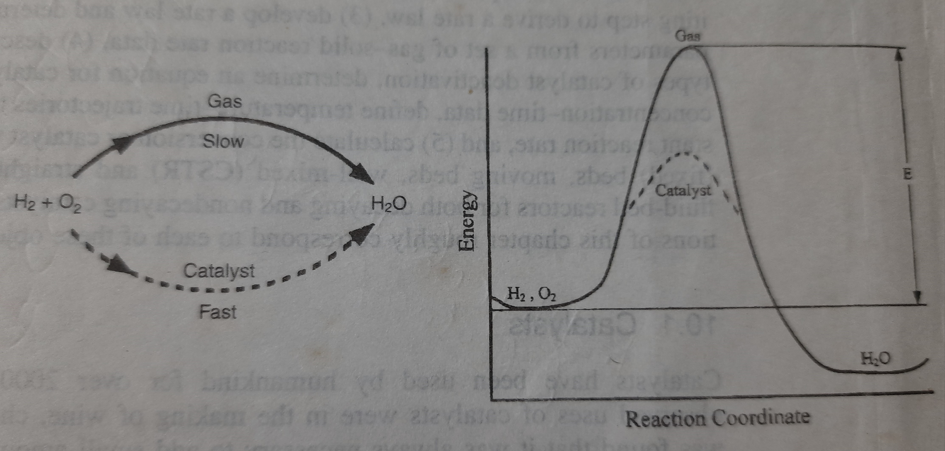
Catalyst and its Properties in a Chemical Reaction
Catalyst is a reagent which either accelerate or retard a chemical reaction without being consumed or converted.
It changes the reaction rate by promoting a different molecular pathway but can not affect equilibrium
It lowers the activation energy of a reaction

Slide 6
Catalysis
Homogeneous Catalysts: Soluble to one of the reactants
Examples: HCl or H₂SO₄ used as catalysts in Liquid phase Friedel Crafts Alkylation reaction, the catalyst is soluble in reaction medium, reaction: C₆H₆ C₆H₅CH₃
Heterogeneous Catalysts: The catalyst remains in separate phase to the reaction medium. Usually the catalysts are solid.
Platinum on alumina catalyst used in dehydrogenation of cyclohexane to produce benzene,
reaction C₆H₁₂ C₆H₆

Slide 7
Heterogeneous Catalysis:
Heterogeneous catalysts are more common.
Advantages of heterogeneous catalysts:
Simple and complete separation of the solid catalysts from reaction medium
Separation of catalysts makes the process economical as no wastage of valuable catalysts
Separation makes the reuse of the catalysts possible
In this part of study, only heterogeneous catalysis will be considered

Slide 8
Contd…
Supported catalyst: Minute particles of active catalysts are dispersed on a less active support. Active particles are mostly metal/ metal-alloy particles, Examples: Pt on alumina (Pt/Al₂O₃) for reforming reaction, V₂O₅ on silica for sulfur dioxide oxidation used for sulfuric acid preparation.
Unsupported catalyst: No support is required, the material is as a whole a catalyst with similar activity throughout its area. Examples: Silica-alumina in dehydrogenation reaction for butadiene preparation
Porous catalyst: The catalyst that has a large area resulting from its pores. More surface area catalysts are more active, as reaction occurs on the surface of the catalyst. Example: Raney Ni used in the hydrogenation of vegetable or animal oils, Fe in ammonia synthesis.
Molecular sieves: Pore structure is such that they allow some molecules and prevent others to enter into the pores of the catalyst, this way they act as sieves. The molecules which can enter into the pores can react with each other to produce products. Examples: Certain clays and zeolites. These are selective catalysts.

Slide 9
Contd….
Heterogeneous catalytic reaction occurs at fluid-solid interface
Hence, a large interfacial area can be helpful or be essential for attaining a significant reaction rate
A porous catalyst has larger surface area resulting from its pore than a non-porous catalyst, example: Raney Ni has surface area up to 1200 m²/g.
Not all catalysts need the extended surface provided by a porous structure, some are sufficiently active.
Most of the catalysts do not maintain their activity at the same level for indefinite period of time, they get deactivated either slowly or rapidly, depending on the nature of catalyst and reaction
Deactivation may be caused by ageing phenomenon, such as gradual change in surface crystal structure or deposition of foreign material on the active portions of the catalyst

Slide 10
Gas phase solid catalytic reaction:
Gas phase solid catalytic reaction needs the reactants to attach to the surface of the catalyst.
This attachment is called adsorption, which may be of two types, 1. Physical adsorption 2. Chemical adsorption
Physical adsorption : Force of attraction between the gas molecules and solid catalyst surface is week, either van dar Waal type, between a permanent dipole and an induced dipole or neutral atom or molecule. Heat of adsorption is small, 1-15 Kcal/gmol.
Chemical adsorption: Force of attraction is strong, the reactant atoms or molecules are bound to the surface atoms of the catalyst by valence bond type force. Chemical adsorption is required for reactants to perform a chemical reaction. Due to chemical adsorption, the electronic structure of reactant molecules are disturbed significantly, making them extremely reactive. Heat of adsorption is in similar magnitude to heat of reaction, i.e., 10-100 Kcal/gmol.

Slide 11
Contd…
The reaction is not catalyzed by the entire solid surface of the catalyst
Adsorption of reactant molecules occurs on specific active centres or sites on the catalyst surface.
The active centres on the surface are originated from: 1. Surface irregularities 2. Dislocations 3. Edges of crystals 4. Cracks along grain boundaries.
So, active centres on the catalyst surface are able to make strong bonds with the reactant molecules and stabilize them.
The parameter to quantify catalyst activity: Turnover frequency—Number of molecules reacting per active sites per second at the condition of experiment
Dispersion D of catalyst: Fraction of the metal ions present on the surface of the catalyst

Slide 12
Steps in a Solid Catalytic Gas Phase Reaction:
The steps involved in the overall process by which a fluid phase reaction with solid porous catalyst happens :
Mass transfer (diffusion) of the reactants from the bulk fluid to the external surface of the catalyst pellet
Diffusion of the reactant from external surface to the internal pore surface through the catalyst pores
Adsorption of the reactant on the internal surface
Reaction on the surface to form product
Desorption of the product from the surface
Diffusion of the product from internal surface to pore mouth/external surface of the catalyst
Mass transfer of the product from external surface to the bulk of the fluid

Slide 13
Contd…
The overall rate of the reaction is equal to the rate of the slowest step of the reaction.
When diffusion/ mass transfer steps are very fast compared to the reaction step, the concentration of reactant/product in the immediate vicinity of the active centres are almost the same as in the bulk phase. So, then diffusion/mass transfer steps can not affect reaction rate. Chemical reaction step will be the rate limiting step.
When rate of chemical reaction is much faster than either adsorption/desorption or diffusion steps, then the rate limiting step may be the slowest step among them.

